Slide 1

Self-Healing Airflow Pipeline
An AI-powered system that automatically detects, analyzes, and fixes data pipeline failures using Apache Airflow, AWS services, and OpenAI's AI models.

Slide 2






The Challenge
Code Errors
Data Issues
Manual debugging increases downtime and operational costs
Schema mismatches and validation errors require intervention
External Failures
Infrastructure Issues
System dependencies and configuration issues
related to the execution environment
Traditional systems detect failures but lack automated recovery mechanisms, leading to prolonged downtime.

Slide 3
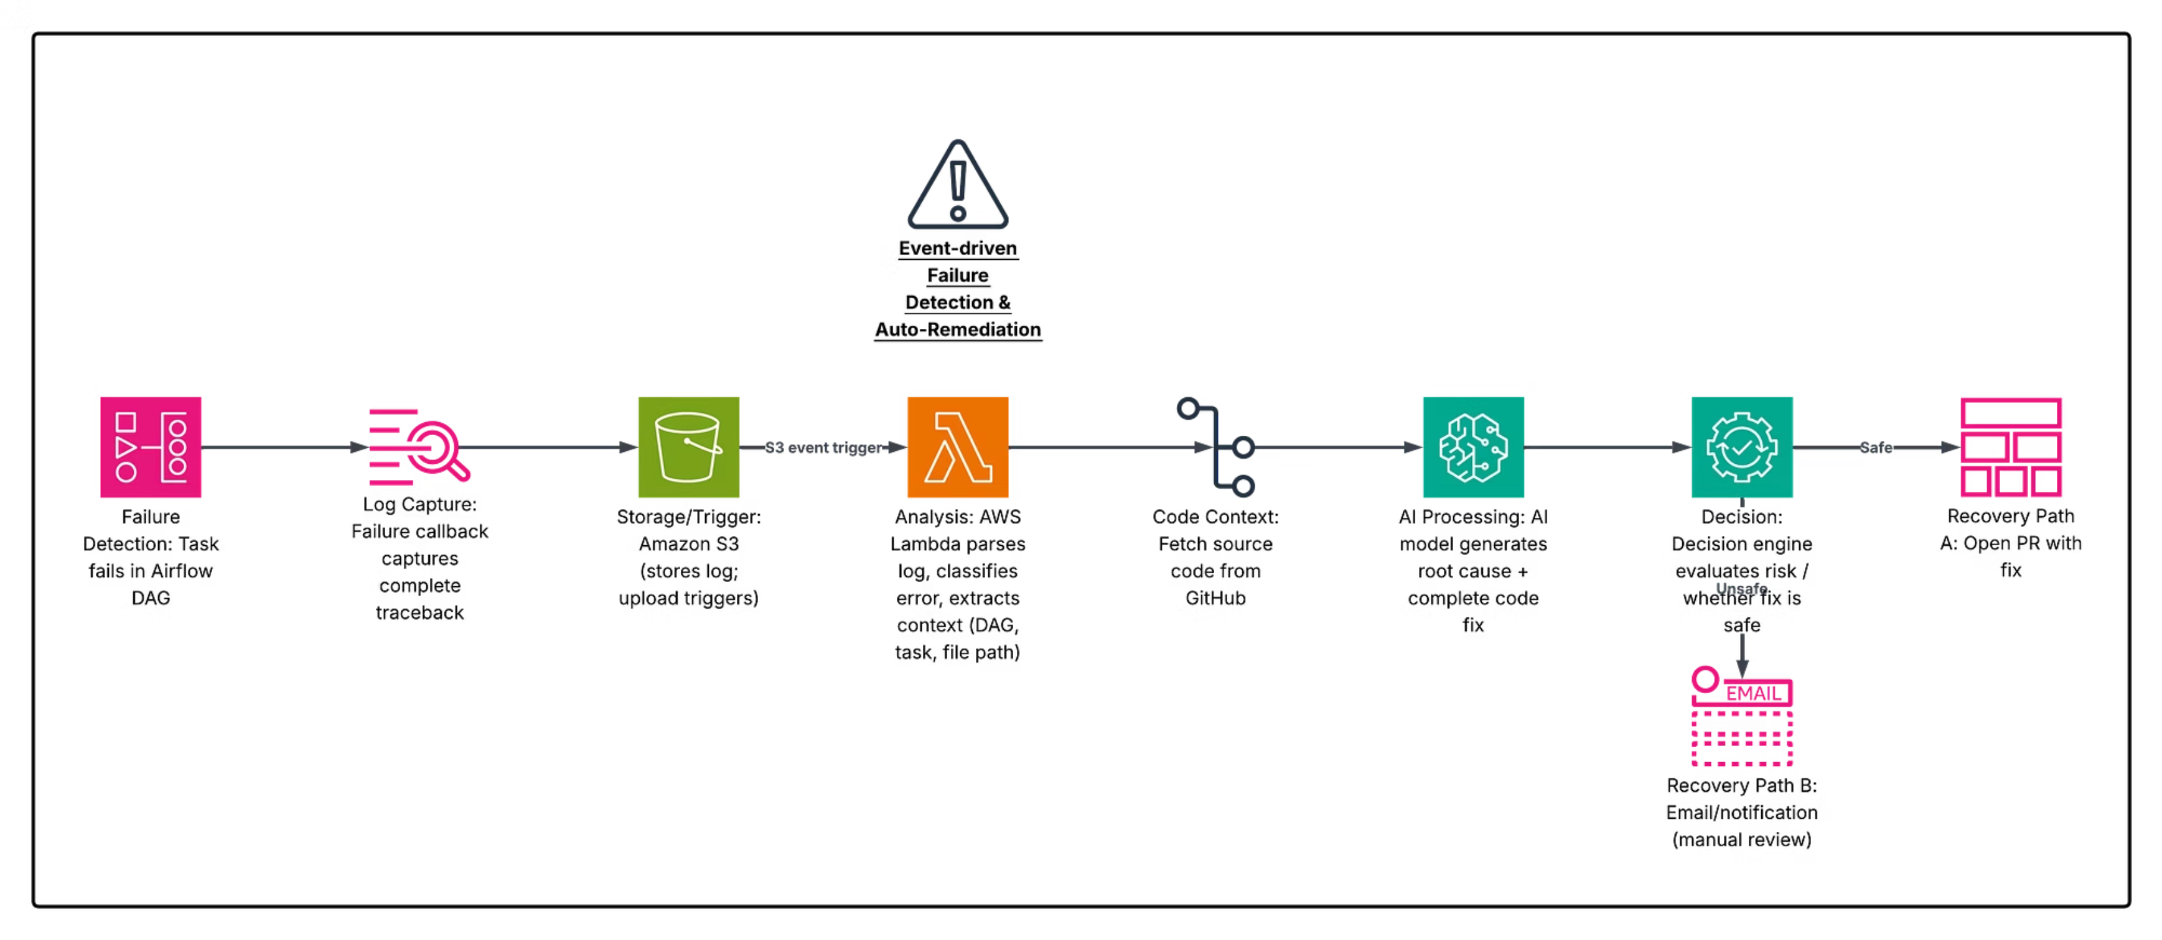
System Architecture

Slide 4
Core Technologies
Apache Airflow
AWS Lambda
Astronomer Runtime for DAG orchestration with failure callback mechanism
Serverless processing for log analysis and decision-making
Amazon S3
OpenAI API
Centralized storage for failure logs and metadata
LLM for root cause analysis and fix generation
GitHub
AWS SES
Version control with automated Pull Request generation
Email notifications for manual review scenarios

Slide 5






Implementation Workflow
Failure Detection
Task fails in Airflow DAG
Log Capture
Callback stores traceback in S3
Analysis
Lambda parses and classifies error
AI Processing
Generates root cause and fix
Decision
Engine evaluates risk level
Recovery
PR or email notification

Slide 6

Three Pipeline Demonstrations
Customer Data Pipeline
1
Processes S3 files, stores in DynamoDB. System detected failure, analyzed issue, and created automated Pull Request with fix.
Sales Analytics Pipeline
2
Data transformation and business insights. Classified as data schema error, sent detailed email notification instead of auto-PR.
Database ETL Pipeline
3
MySQL to DynamoDB extraction. Demonstrated controlled automation with decision engine evaluating confidence scores.

Slide 7
Decision Engine Logic
AI Input
AI Output
Error logs and traceback
DAG context and metadata
Task code and imports
Full source file
Root cause explanation
Suggested fix description
Corrected code (full file)
Confidence score and risk level
High Confidence + Low Risk
Low Confidence or High Risk
Automated Pull Request created
Detailed email notification sent
Ensures safe automation by preventing unsafe changes while enabling rapid recovery for verified fixes.

Slide 8

Limitations and Future Scope
Current Limitations
Future Enhancements
AI accuracy dependency
External system failures
API and network dependency
Security considerations
Fine-tuned domain models
Automated rollback mechanisms
Real-time monitoring dashboard
Multi-language support

Slide 9

Conclusion
Autonomous Recovery
Event-Driven Architecture
Shift from reactive monitoring to proactive, intelligent systems with minimal human intervention
Robust integration of Airflow, AWS services, and AI models for scalable processing
Safe Automation
Decision engine ensures controlled deployment through confidence and risk evaluation
This system demonstrates a practical implementation of self-healing data pipelines, reducing downtime and operational costs while maintaining code quality and traceability through GitHub workflows.

Slide 10
Thank You !!

